Slide 1




TITLE 1
ANNUAL MEETING 2025-2026
Osceola Elementary School
Principal: Ms. Jessica Mead
Assistant Principals: Ms. Adriana Orta and Mr. B.J. Esguerra

Slide 2


AGENDA
Overview of Title 1
Use of title 1 Funds
parental Rights
School Parent Compact
Accountability
Parental Involvement
Next Steps

Slide 3

ABOUT TITLE 1
Title I is the largest federal assistance program for our nation’s schools.
The goal of Title I is to address the academic needs of students and to assist them in meeting their state’s academic standards.
The program serves 16 schools in St. Johns County including eligible students in 3 non-public schools.

Slide 4


Title I Funding
Increased Student Achievement
St. Johns County Schools
Federal Government
1
3
2
4
Florida Department of Education
Osceola Elementary School

Slide 5

TITLE 1 SUPPORTS PROVIDE:
Smaller Classes
Additional teachers and paraprofessionals
Additional training for school staff
Extra time for instruction (before and after school programs)
Parent and family engagement activities
A variety of supplemental teaching materials, equipment and technology
Notes:
Title I funds are used to supplement the program at the school by providing funds which support the following types of activities:
Additional teachers and paraprofessionals to create smaller classes
Additional training for school staff
Extra time for instruction (Before and/or after school programs)
Parent and Family Engagement Activities
A variety of supplemental teaching methods and materials

Slide 6

WORKING TOGETHER FOR STUDENT SUCCESS
As a Title I parent you have the right to be involved in the development of the following plans and documents for our school which can be found on our website or available in print upon request.
  School Improvement Plan (SIP)
  School-Parent-Student Compact
Through School Advisory Council (SAC) and parent meetings
  Parent and Family Engagement Plan (PFEP)

Slide 7


PARENT’S RIGHT TO KNOW
As a parent of a student attending a St. Johns County Public School, you have the right to:
1. Be provided information on your child’s level of achievement on assessments in Reading/Language Arts, Writing, Mathematics, and Science.
2. Request and receive information on the qualifications of your child’s teacher and supplemental personnel working with your child.
3. Be notified if your child’s teacher is teaching out-of-field.
4. Be informed if your child is taught by a teachers who does not meet state certification or licensure requirements for four or more consecutive weeks.

Slide 8


PARENT-SCHOOL- STUDENT COMPACT
▷The Parent-School-Student Compact is updated every year to include parent, student, teacher, and staff input. Parent, student, teacher and staff comments are welcome at any time during the year.
▷This was sent home at the beginning of the year, please let your child’s teacher know if you need an additional copy.
Notes:
The purpose of the compact is to foster student achievement. By signing the Parent-School-Student Compact, Enter School name Elementary, teachers, staff, parents and students agree to work together to share the responsibility of helping students meet or exceed state, district and school academic goals.
8

Slide 9


ACCOUNTABILITY
  School Report Cards
    School Grade and Overview
    Population and Enrollment
    Assessments – Academic Achievement, Growth, and Population
    Assessments – English Language Learners
    Graduation and Beyond
    Educator Qualifications and Equity
    Long-Term Goals and Interim Progress
    Accelerated Course Enrollment
    Per-Pupil Expenditures
    National Data
  Available online at https://edudata.fldoe.org/ or by request.

Slide 10
OES SCHOOL GRADE DATA 24-25
Reading | Reading 3ʳᵈ Grade | Reading Gains | Reading Gains Lowest Quartile | Math | Math Gains | Math Gains of the lowest quartile | Science | Total Points | 2024-2025 School Grade
69 | 75 | 57 | 42 | 70 | 65 | 52 | 70 | 500 | A

Slide 11


Florida’s academic content standards establish high expectations for all students.
Florida Standards identify what your child needs to know and be able to do in all content areas. You may read more information by visiting fldoe.org/academic/standards/.
Your child’s teacher will explain the standards for your child’s grade level during Curriculum Night.

Slide 12
ASSESSMENTS
Pre K (VPK Students ONLY) | STAR Early* Literacy
Kindergarten | STAR Early* Literacy | STAR Math*
1ˢᵗ Grade | STAR Early* Literacy | STAR Reading | STAR Math*
2ⁿᵈ Grade | STAR Reading* | STAR Math*
3ʳᵈ Grade | FAST Reading* | FAST Math*
4ᵗʰ Grade | FAST Reading* | FAST Math* | BEST Writing
5ᵗʰ Grade | FAST Reading* | FAST Math* | BEST Writing | SSA Science
Assessments with * are given 3 times/year for progress monitoring.
All others are only given in April or May.

Slide 13

Working Together for Student Success
Please join us…
Oct 9ᵗʰ: Goodies with Grands
Oct 24ᵗʰ: Trunk or Treat
Dec 4ᵗʰ: Winter Concert
Jan 22ⁿᵈ: Muffins with Moms
Feb 6ᵗʰ: Sweetheart Social
March 5ᵗʰ: Donuts with Dudes
March 26ᵗʰ: STEAM Night
May 14ᵗʰ: Night of the Arts

Slide 14

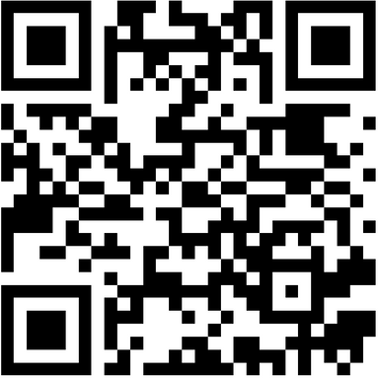


NEXT STEPS
We encourage
you to…
stay involved through joining SAC, PTO, or volunteering.
JOIN PTO
communicate with the teachers and other
staff regularly.
participate in giving your input for our SIP, PFEP, and Compact.

Slide 15
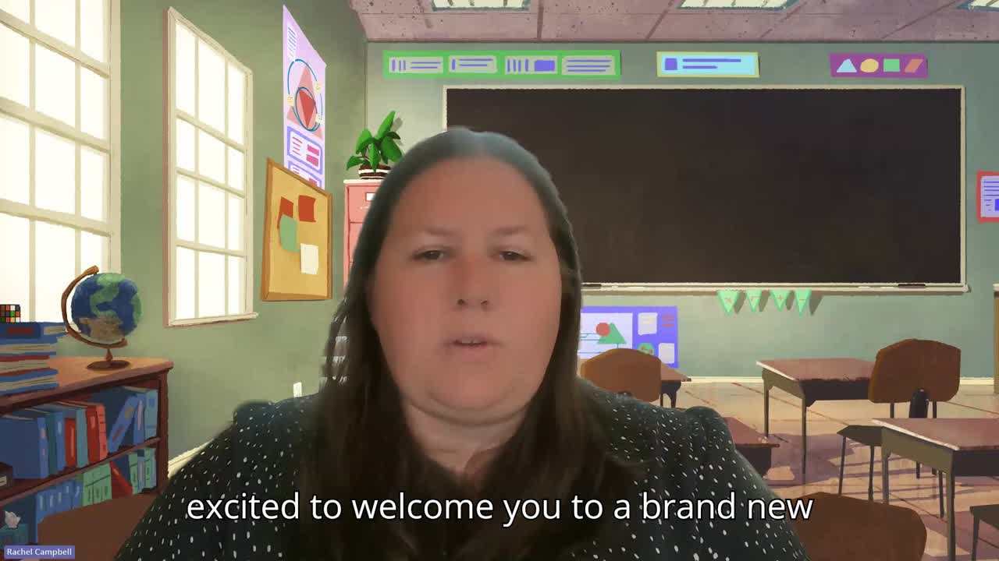
A message from the PTO:
A message from the PTO
15

Slide 16

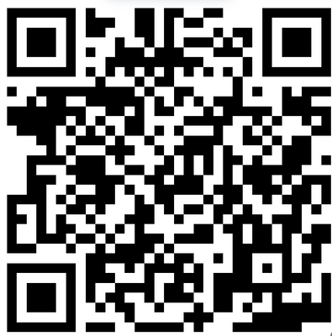
PARENT SQUARE
SIGN UP NOW
  New tool for communications from School and District
  Will include:
    School Story
    Classroom Story
    Direct messaging with teacher
  Will replace DOJO November 1ˢᵗ
For more information or to register:

Slide 17


STAY CONNECTED WITH US!
Important information from your child’s teacher will be shared on Parent Square
Be sure to read our school newsletter each month for updates.
Visit our school website for up to date information.

Slide 18


Please ensure that your current contact information is on file to stay informed about what’s occurring at your child’s school and in the district. Parents and guardians can receive phone calls, emails and text messages.
18
Notes:
18

Slide 19

THANK YOU!

